Slide 1
Formative Project 1.1
UX - Design

Slide 2
Contents-
Content Strategy
Research
Competitive analysis
Surveys
Observation
Interviews
Design-
A. User personas
B. Prototypes - a. Wireframes
b. Mock-ups

Slide 3
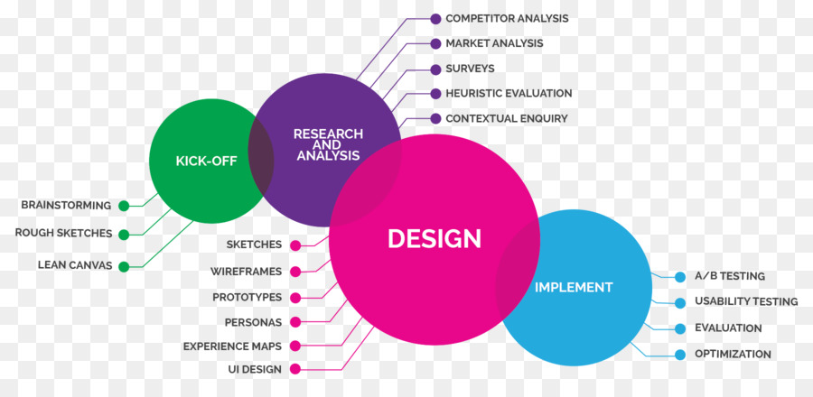
UX- process

Slide 4
Content Strategy
Taste of India, Miramar, Wellington
https://tasteofindiamiramar.weebly.com/
Project- brief
Taste of India Miramar is looking to update their existing website in order to encourage orders via the site, as well as improve the information present on the site.
As the store is take-away only there is no need for an online delivery service however a system to place and pay for pick-up orders online could be implemented depending on our research results.
The existing site lacks relevant information about the store, a text menu, information on the contact page as well as any images of the store or food sold within.

Slide 5
Our research will focus on what elements users wish to see most on a restaurant page, with our assumption being that contact/location information, ordering functions and imagery to be the highest priority.
Fonts
We wanted our font choice to reflect the fonts used on the physical store front, while keeping the body text simple enough to increase readability.
For our header we used a similar high width sign-painter style font, named sansita, which has minimal flicks to retain readability on mobile screens while retaining a distinctive appearance to the body text
Colors
For our main colors we again took inspiration from the physical store front, using a subdued pink color for body background, and a darker shade for separate elements such as header navigation.

Slide 6
Our highlight color is a similar yellow to what appears on the store-front, however again subdued a little to ease the contrast when viewed on screens.
These two colors create a visual link to the physical location, as the store operates as take-away only we thought users might appreciate a visual confirmation that the store and site are linked.
Imagery
Due to the site having minimal imagery of their own on the site, we chose to add in imagery related to the services they offer, specifically images of curry dishes and various ingredients used in indian cooking.
We decided to forgo having images present on our mobile order system to save space, instead having thumbnails present on the menu for users to click and see a larger image of each dis if needed, this was backed up in our research with most being indifferent to having images alongside the menu.

Slide 7
Research
Here we start our research part for making our website effective and efficient for user. For that our first task was to perform “Competitive Analysis”.
We found 2 strong Indian restaurants in the same area Miramar, Wellington.
Tulsi Contemporary Indian cuisine, Miramar (Wellington)
https://tulsi.co.nz/tulsi-miramar/
The Balti house, Miramar (Wellington)
http://www.baltihouse.co.nz/

Slide 8
Competitive Analysis
https://vandy.xtensio.com/ummjqv0w
 | Competitor 1 The Balti House, Miramar | Competitor 2Tulsi Contemporary Indian Cuisine, Miramar
Overview | The Balti House is a Indian cuisine restaurant, famous for basically Balti curries and origins from upper region of Kashmir (India) with great cuisine and menu. | Tulsi is Wellington's favourite Indian restaurant Brand.
Target customers | Residential | Residential
Pricing of products & services | Reasonable prices, lunch, dinner and takeaway service | High quality food, excellent fast service, low prices, Lunch/Takeaway/dinner service
Marketing Strategy | Attracts Miramar's residents with it's curry based lunch/dinner/takeaway service | Emphasizes on Resonable price and fast service
Competitive Advantage | Food cuisine mainly based on upper regions of Kashmir,India. Focus on Balti curries. | Tulsi has been voted for best Butter chicken dish by Breeze radio, also received 4 star excellent rating for its food, ambience and service by Wellington's famous food critic Mr. David Burton.

Slide 9
Surveys
We generated some quick questions to get users’ response.
Survey Questions-
Do you eat at restaurants?
Do you order food online?
Do you browse website before ordering?
Do you think, images are important for website?
Do you prefer to pay online for your food?
And put these questions online via SurveyMonkey port to collect users 'responses.
https://www.surveymonkey.com/r/JDR6BVT
https://www.surveymonkey.com/analyze/QEU9k_2BJiV76m1FfrAef_2BBJPuSzewNUK9FHM1lKAllsw_3D?tab_clicked=1

Slide 10
Questionnaire/ Observation
We designed some questions for observation to find out the elements to be improved.
Questionnaire questions-
1. Can you please find Butter Chicken dish on website?
2. Can you please find further information about restaurant?
3. Could you please locate contact number of the restaurant?
4. Are you able to find restaurant location on map?
5. Can you please find restaurant opening hours on website?

Slide 11
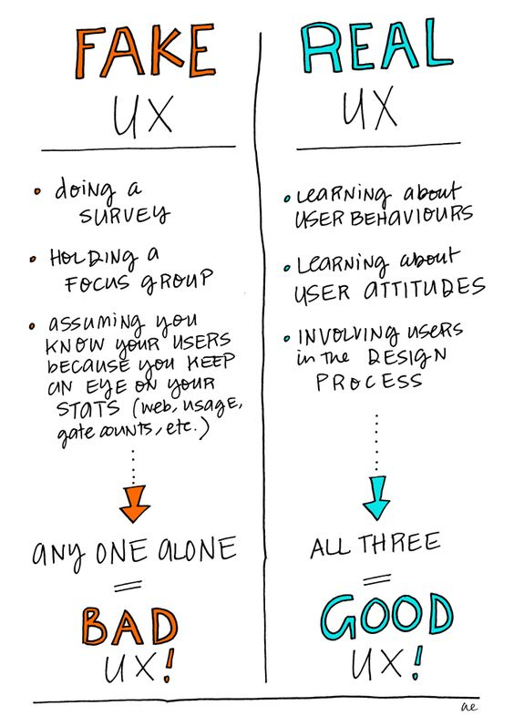

Slide 12
Interviews
Our team conducted direct interviews with different users to know their opinions about the website in detail.
Interview Questions- ( done with 3 users)
(one of them)
Would you order from this restaurant or will try another restaurant website?
Ans. I will try another website as this restaurant website is not user friendly at all, has old designed pale menu, not inviting, not digital and not interactive, also with incomplete information.
2.Would you rather order online or through the phone?
Ans. I will order online because normally it’s easy to browse menu online and total amount to be spent. But this website has no facility to order and pay online.

Slide 13
Do you require image of each item in menu to help decide?
Ans. Yes it helps imagining the dish.
Do you have a regular Indian restaurant website where you order from?
Ans. No, I don’t have.
What are your viewpoints for this website? What would you like to see added to this website?
Ans. There are certain points to improve like, contact details and Map should be under contact page rather than the home page.
About page to be maintained.
Images of menu items to be added, present menu is unappealing.
Opening hours of restaurant must appear on landing page clearly.
Social media page button should be connected through.
Order now button (for ordering online service) missing.

Slide 14
Research Analysis
Questionnaire Qus. | User1 | User2 | User3 | User4 | Number "Found"
Can you please find Butter Chicken dish on the website? | Found | Found | Found | Found | 4
Can you please find further information about the restaurant? | Couldn't find | Couldn't find | Couldn't find | Couldn't find | 0
Locate contact number of the restaurant. | Couldn't find | Found | Couldn't find | Couldn't find | 1
Are you able to find restaurant location on map? | Couldn't find | Found | Found | Found | 3
Could you please find restaurant opening hours on the website? | Couldn't find | Couldn't find | Couldn't find | Couldn't find | 0

Slide 15
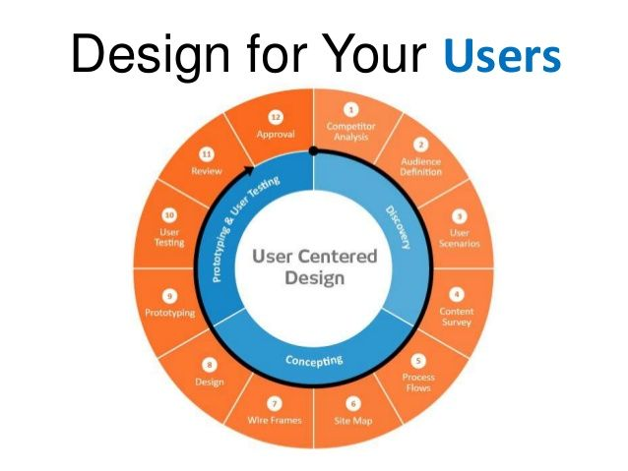
Design

Slide 16
User Persona
A user persona is a fictional representation of your ideal customer.
A persona, in user-centered design and marketing is a fictional character created to represent a user type that might use a site, brand, or product in a similar way.
Creating personas will help you to understand your users' needs, experiences, behaviors and goals.

Slide 17
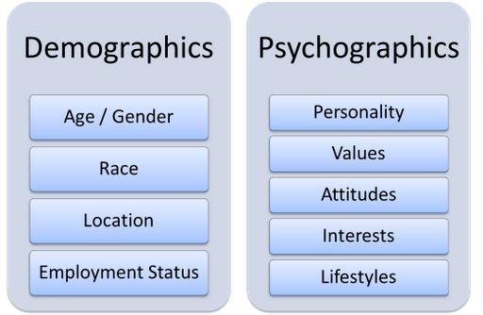
Types of User (Target Audience)

Slide 18
https://vandy.xtensio.com/4706c5vg

Slide 19
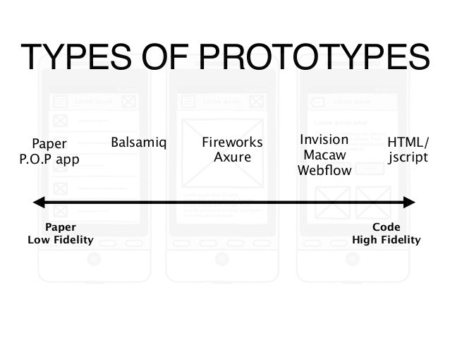
Prototypes
A prototype is an early sample, model, or release of a product built to test a concept or process. It is a term used in a variety of contexts, including semantics, design, electronics, and software programming.

Slide 20
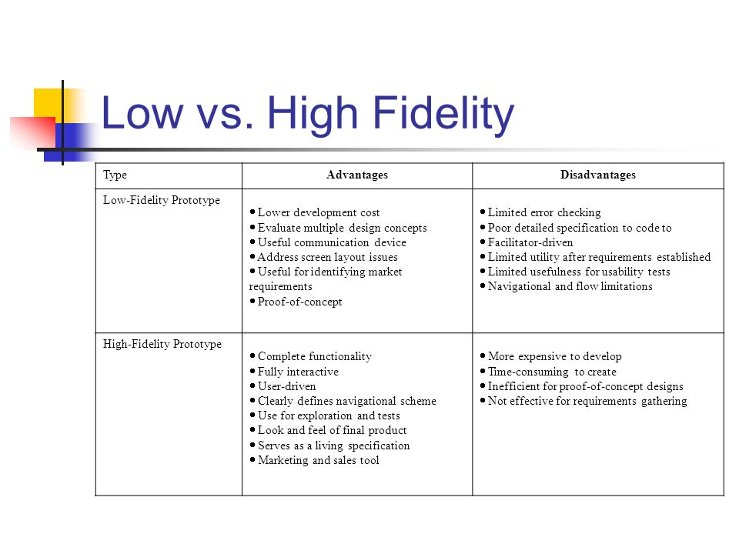

Slide 21
Wireframes
https://tasteofindiamiramar.weebly.com/
A wireframe is a low-fidelity way of showing a design. It’s the graphic representation of an app or a website containing the most essential elements and the content. A wireframe is like a blueprint of a building. When someone wants to build a massive building, they don’t start right away, right. Instead, they sketch, draw, make the blueprints, calculate, etc.
Features of Wireframes-
1. It shows the main chunks of content
2. It draws the outline and the layout structure
3. It depicts the most basic UI

Slide 22
Home

Slide 23
About & Contact

Slide 24
Menu

Slide 25
Order

Slide 26
Mobile wireframe

Slide 27
Mock-ups
A mockup is a visual way of representing a product. While a wireframe mostly represents a product’s structure, a mockup shows how the product is going to look like. But still, a mockup is not clickable (just like the wireframe)
A mockup helps you make final decisions regarding a product’s color schemes, visual style, typography.

Slide 28
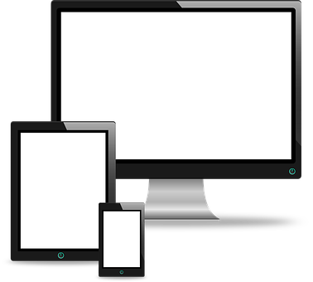
Prototyping needs to be accomplished for all 3 types of measurements devices-
Desktop/ Tablet and Mobile version.

Slide 29
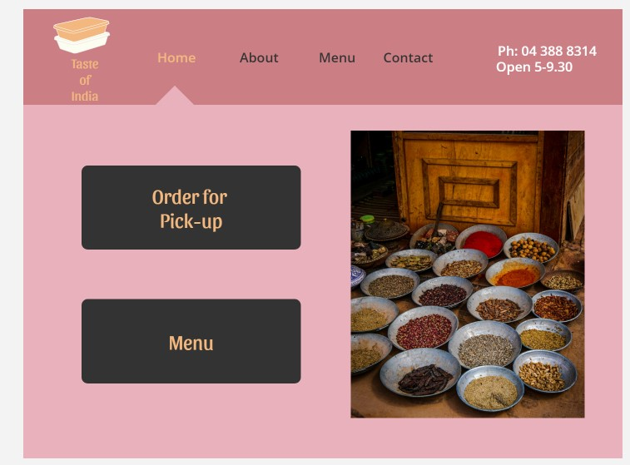
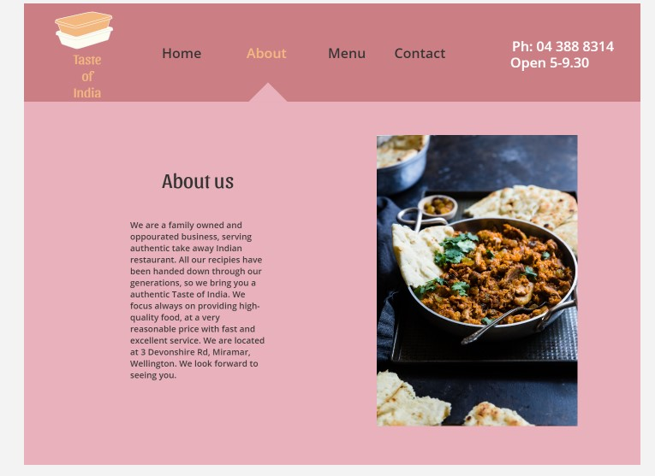
Desktop version
https://preview.uxpin.com/3e9247d32cf37c88eef03fe042dd3401ef9337e4#/pages/116097485/simulate/no-panels?mode=i

Slide 30
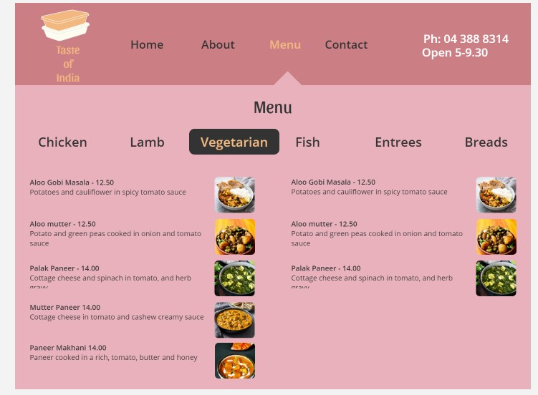
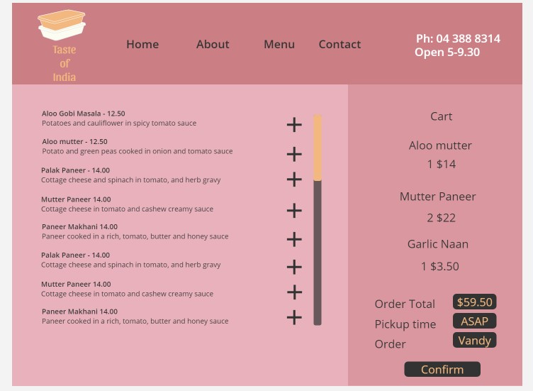

Slide 31
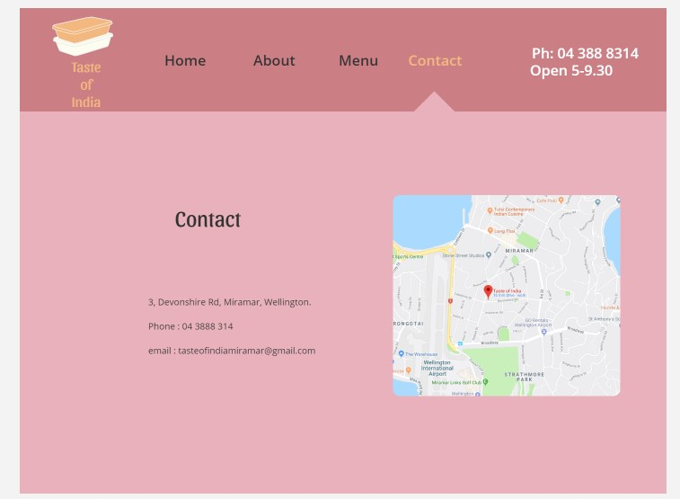

Slide 32
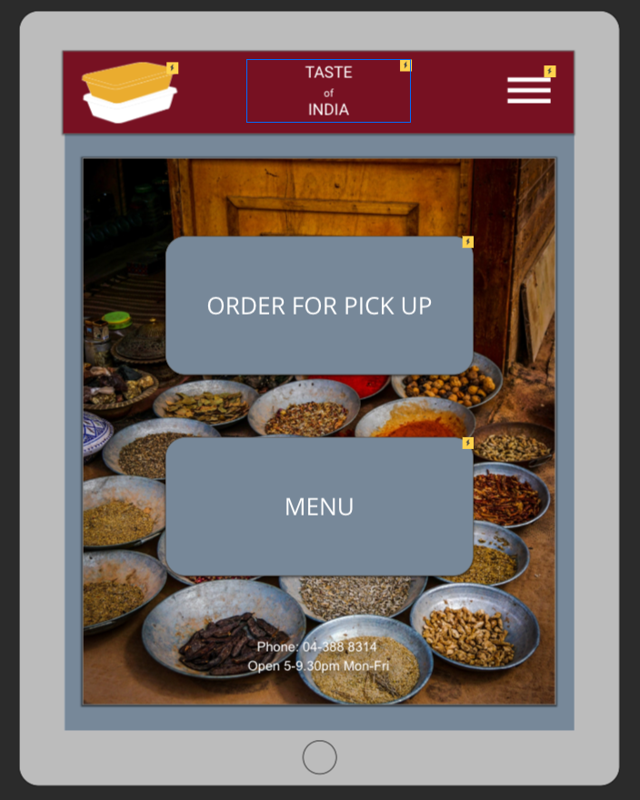
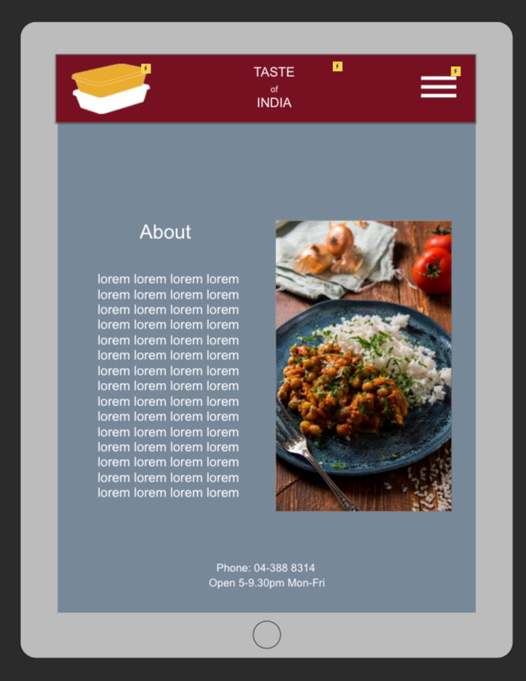
Tablet/iPad version

Slide 33
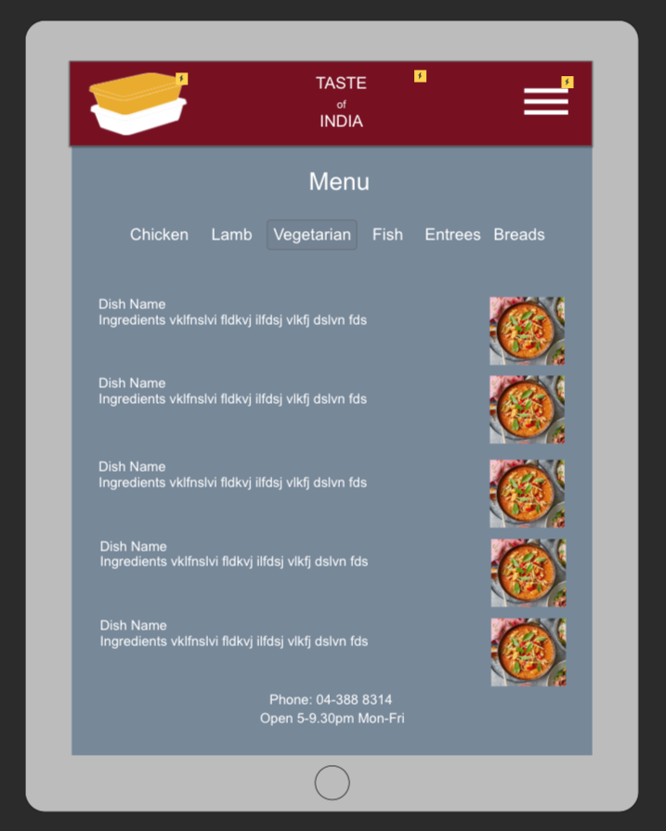
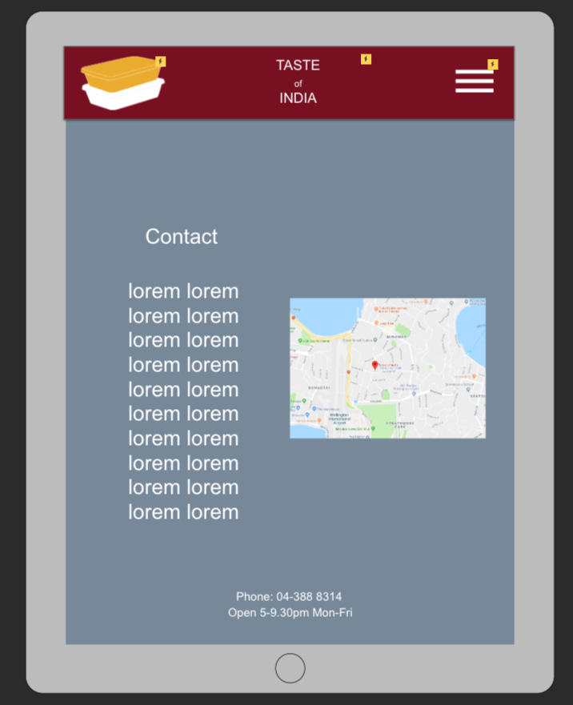

Slide 34
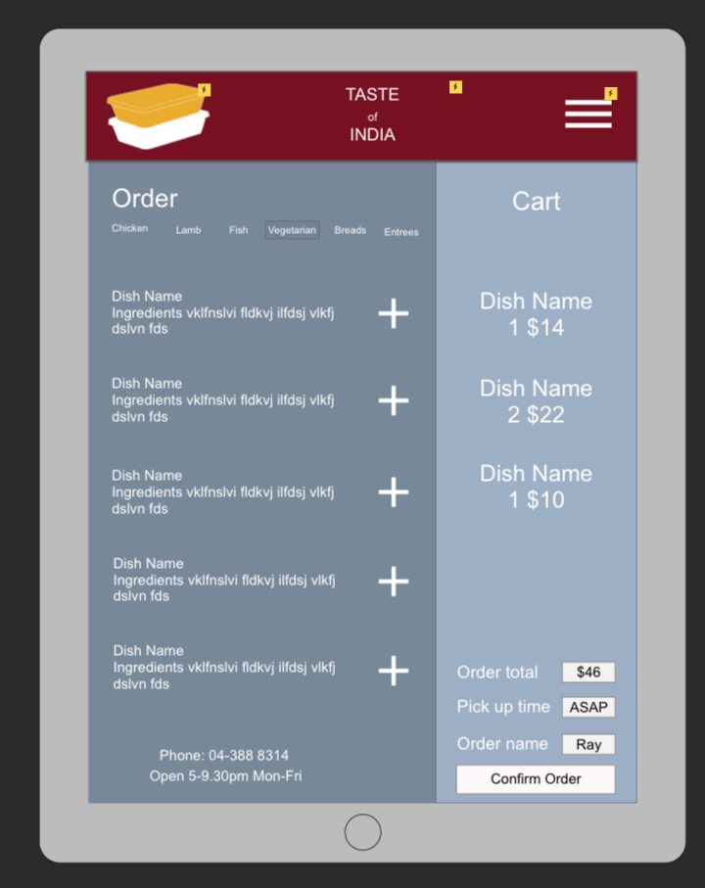

Slide 35
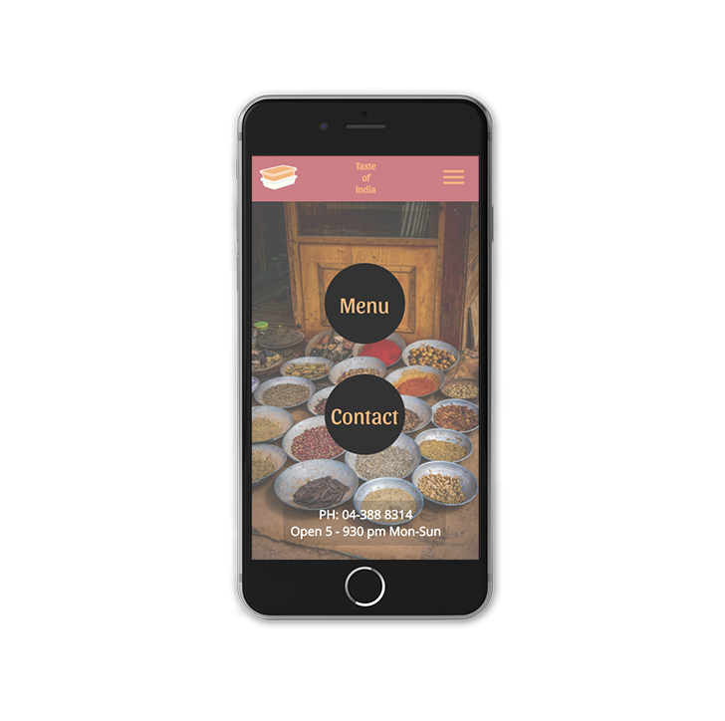
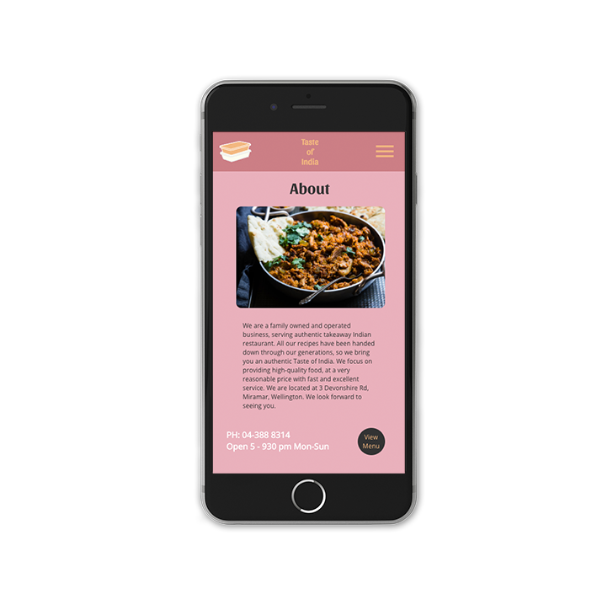
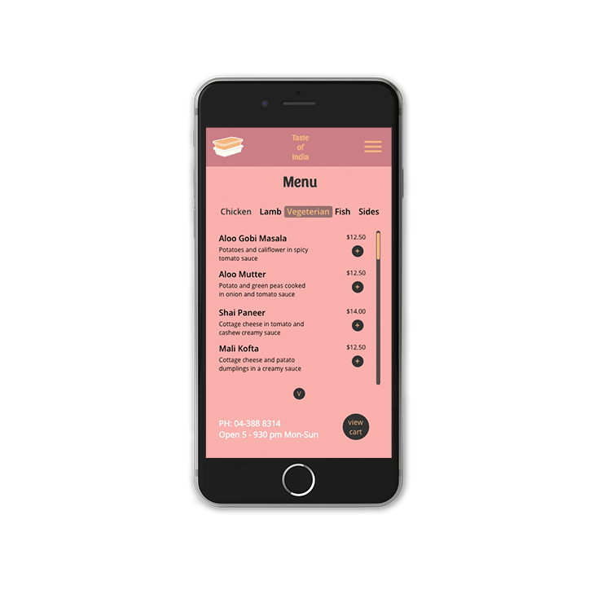
Mobile version

Slide 36
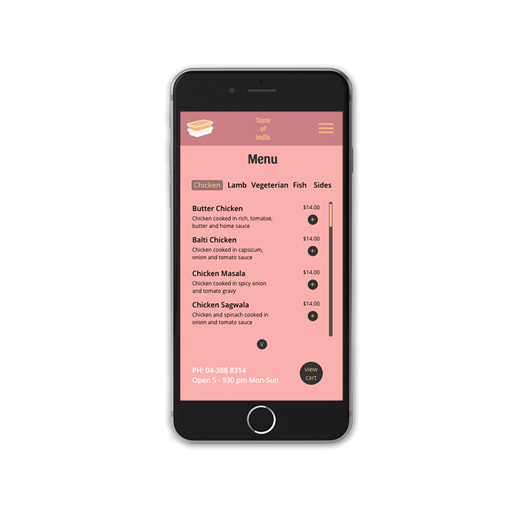
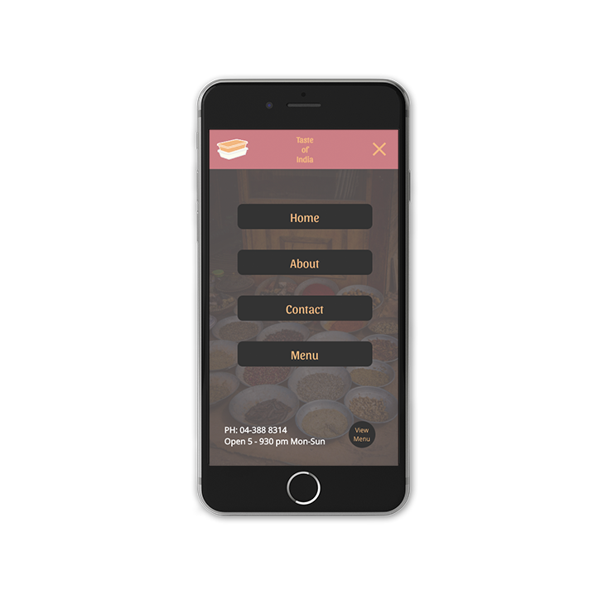
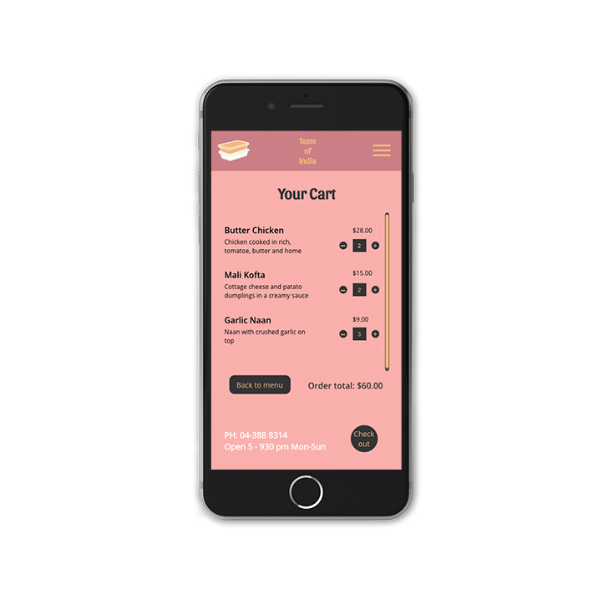

Slide 37
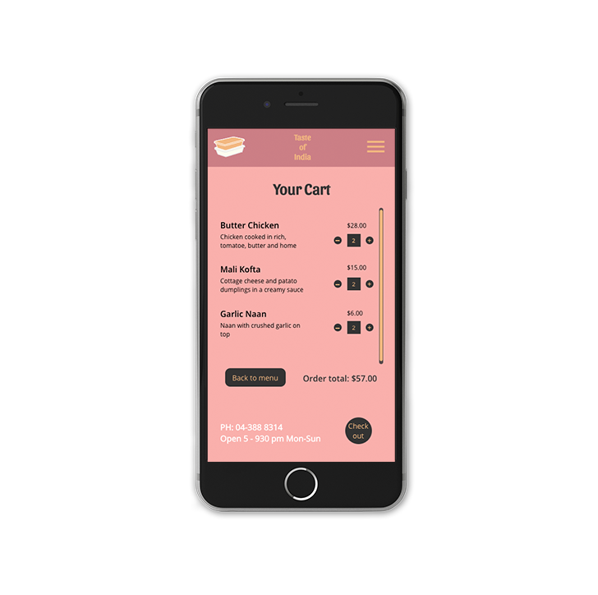
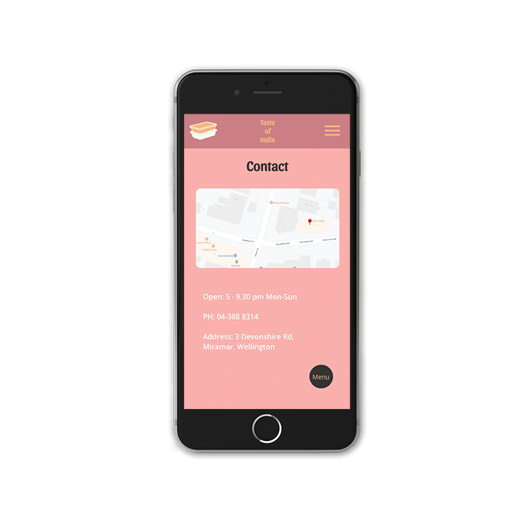
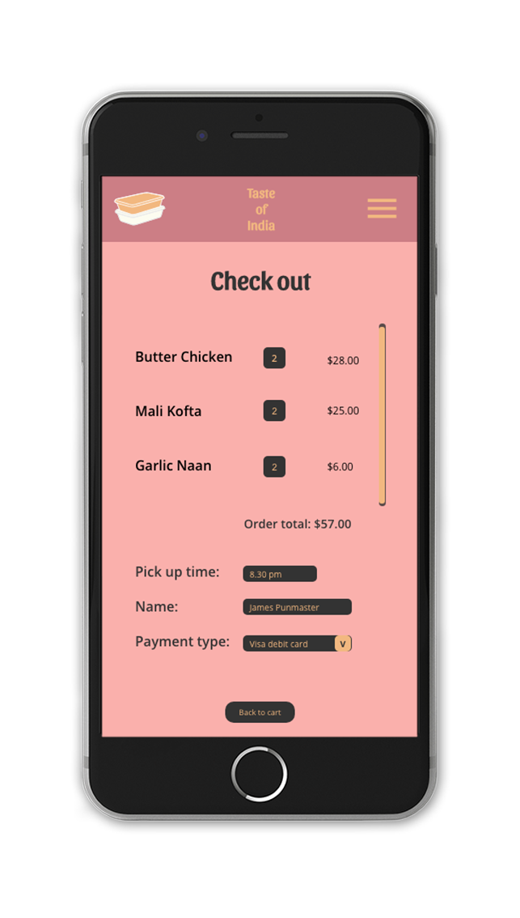

Slide 38
Documentation

